Slide 1
AI Face Following with Jetson Nano
2022 Mike Soniat

Slide 2
Project
Build a face following AI-enabled camera
Use OpenCV library for computer vision
Use the Jetson Nano Developer Kit
Use pan and tilt servos to center web cam on faces

Slide 3

OpenCV
OpenCV is an open-source computer vision and machine learning software library.

Slide 4
Haar Cascades
OpenCV offers open-source Haar models that can be downloaded for free on github. For this project, I will use the Frontal Face Default and Frontal Eye Detector.
opencv/data/haarcascades/haarcascade_frontalface_default.xml
opencv/data/haarcascades/haarcascade_eye.xml
Object Detection using Haar feature-based cascade classifiers is an effective object detection method proposed by Paul Viola and Michael Jones in their paper, "Rapid Object Detection using a Boosted Cascade of Simple Features" in 2001. It is a machine learning based approach where a cascade function is trained from a lot of positive and negative images. It is then used to detect objects in other images.

Slide 5
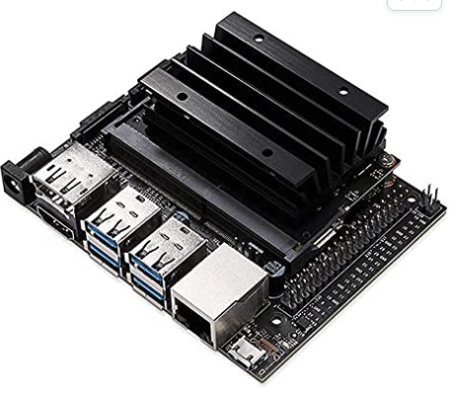
Main Components
NVIDIA Jetson Nano Developer Kit
This developer kit is a small, powerful computer that lets you run multiple neural networks in parallel for applications like image classification, object detection, segmentation, and speech processing. All in an easy-to-use platform that runs in as little as 5 watts.

Slide 6
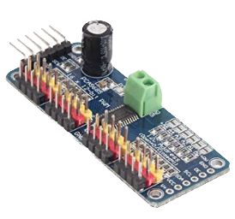
Main Components
PCA9685 16 Channel 12-Bit PWM Servo Motor Driver IIC
Communication Interface: IIC
16-way steering gear control
Voltage: DC5-10V power supply
The PCA9685 chip is wrapped in the center of the board
All PWM output lines have a 220 ohm series resistor protection and can easily drive LED.

Slide 7
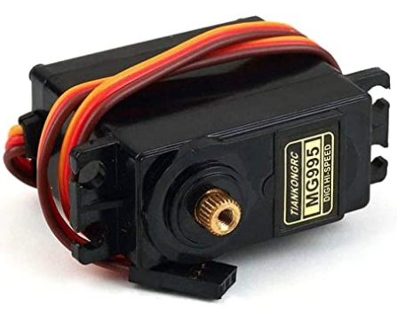
Main Components
2 Standard Servos

Slide 8
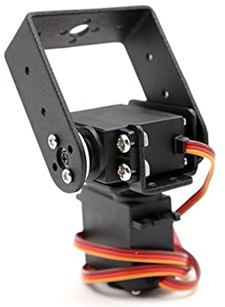
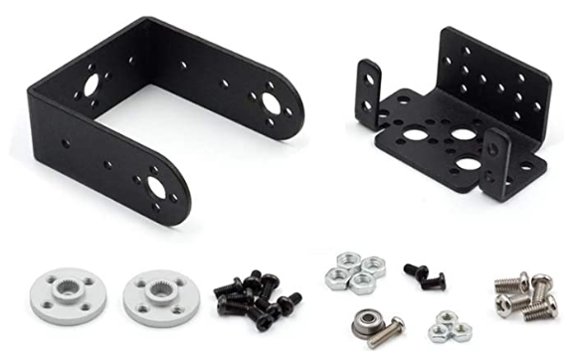
Main Components
Pan Tilt Servo Mount Bracket

Slide 9
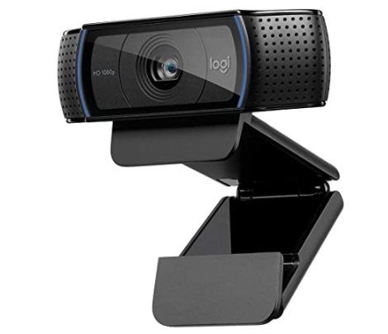
Main Components
Logitech HD Pro Webcam C920

Slide 10
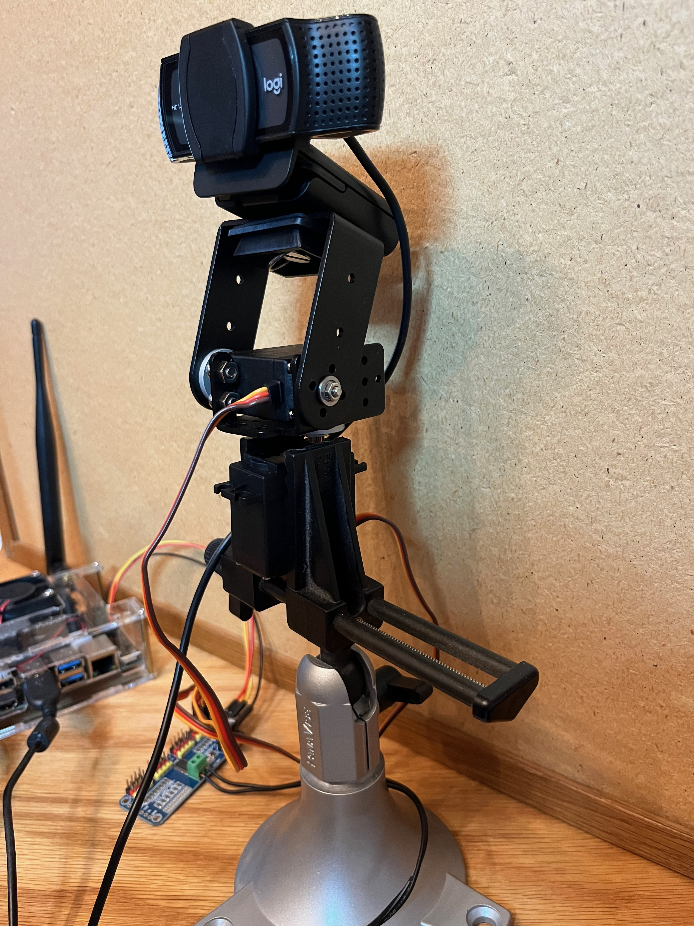
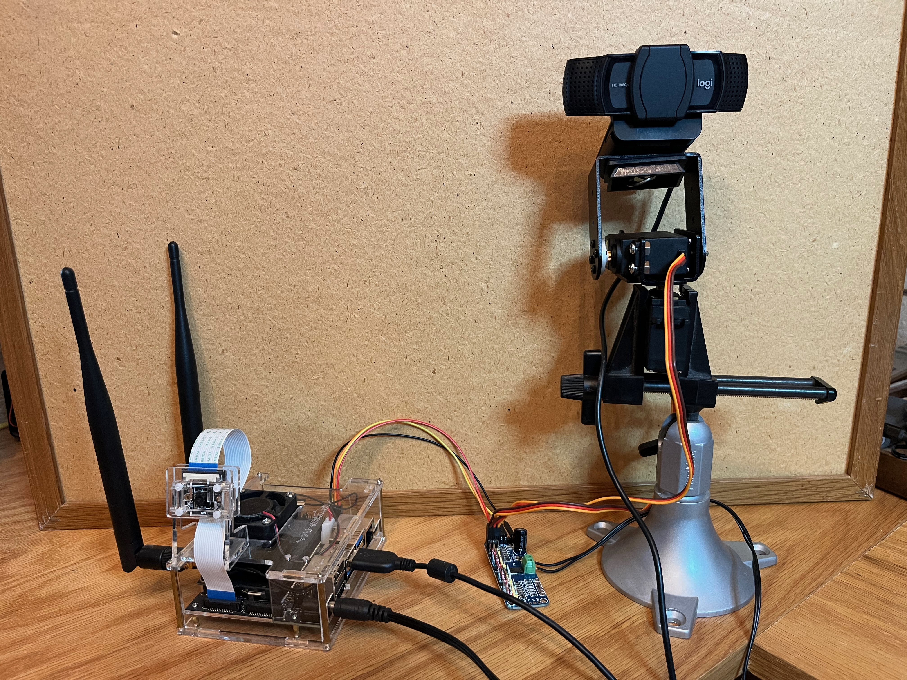
All Wired Up
NOTE: I also have a Raspberry Pi camera attached to the Jetson Nano (as shown). It is not being used for this project.

Slide 11
Live Demo

